Slide 1

AI and Machine Learning for IoT Big Data

Slide 2
Case study 3

Slide 3
Outline of the lecture
Sensory data often has both spatial and temporal distribution, and it could be important to be able to process both together.
In this case study, we consider a dataset collected by the EPA over decades and over the whole US, for carbon monoxide (CO) pollution.
We will use Python libraries to access, analyze, and visualize the data, and draw some conclusions about its characteristics.

Slide 4
Where are we in the Course?
Introduction: Background of IoT, Big Data, AI
Collect, analyze data from IoT on a large scale
Elements and practice of statistics
AI methods for data science
Getting further with AI: internal workings
Practical usage of AI for Big Data from IoT
Moving into the real world

Slide 5
Lecture 12: Big Data from Sensors
Case study: Carbon Monoxide Daily Summary
The US EPA CO data on Kaggle
The “Feature engineering” kernel
Exploring the data
Spatial features
Temporal features
Self-study hints

Slide 6
CO survey by nationwide sensor array
Breathing air with a high concentration of CO reduces the amount of oxygen that can be transported in the blood stream to critical organs like the heart and brain.
https://www.epa.gov/co-pollution/basic-information-about-carbon-monoxide-co-outdoor-air-pollution#Reduce
Notes:
Point students to the rich datasets provided on the EPA web pages.

Slide 7
EPA CO data on Kaggle
8 million records of curated sensor data
Span: 1994-02-01 to 2017-07-31
Coverage: whole USA (incl. Hawaii)
Contents: CO sensor value (ppm) daily aggregated value daily maximum, its time
Some missing values, errors
https://www.kaggle.com/epa/carbon-monoxide
Notes:
What other pollution looks important?

Slide 8
Visualization on the EPA web pages
https://www.kaggle.com/epa/carbon-monoxide/data
https://www.epa.gov/outdoor-air-quality-data/air-data-concentration-map
Notes:
This visualization will be recreated during the lecture.

Slide 9
Data fields
County Code: The FIPS code of the county in which the monitor resides.
Site Num: A unique number within the county identifying the site.
Parameter Code: The AQS code corresponding to the parameter measured by the monitor.
POC: This is the “Parameter Occurrence Code” used to distinguish different instruments that measure the same parameter at the same site.
Latitude: The monitoring site’s angular distance north of the equator measured in decimal degrees.
Longitude: The monitoring site’s angular distance east of the prime meridian measured in decimal degrees.
Datum: The Datum associated with the Latitude and Longitude measures.
Parameter Name: The name or description assigned in AQS to the parameter measured by the monitor. Parameters may be pollutants or non-pollutants.
https://www.kaggle.com/epa/carbon-monoxide
Notes:
Geographical information: discuss handling in Scala (GeoJSON) and Python

Slide 10
Data fields
Sample Duration: The length of time that air passes through the monitoring device before it is analyzed (measured). So, it represents an averaging period in the atmosphere (for example, a 24-hour sample duration draws ambient air over a collection filter for 24 straight hours). For continuous monitors, it can represent an averaging time of many samples (for example, a 1-hour value may be the average of four one-minute samples collected during each quarter of the hour).
Pollutant Standard: A description of the ambient air quality standard rules used to aggregate statistics. (See description at beginning of document.)
Date Local: The calendar date for the summary. All daily summaries are for the local standard day (midnight to midnight) at the monitor.
Units of Measure: The unit of measure for the parameter. QAD always returns data in the standard units for the parameter. Submitters are allowed to report data in any unit and EPA converts to a standard unit so that we may use the data in calculations.City Name: The name of the city where the monitoring site is located. This represents the legal incorporated boundaries of cities and not urban areas.
https://www.kaggle.com/epa/carbon-monoxide
Notes:
Data-time: discuss handling in Scala, Python

Slide 11
Data fields
Observation Count: The number of observations (samples) taken during the day.
Observation Percent: The percent representing the number of observations taken with respect to the number scheduled to be taken during the day. This is only calculated for monitors where measurements are required (e.g., only certain parameters).
Arithmetic Mean: The average (arithmetic mean) value for the day.
1st Max Value: The highest value for the day.
1st Max Hour: The hour (on a 24-hour clock) when the highest value for the day (the previous field) was taken.
AQI: The Air Quality Index for the day for the pollutant, if applicable.
Method Code: An internal system code indicating the method (processes, equipment, and protocols) used in gathering and measuring the sample. The method name is in the next column.ted. This represents the legal incorporated boundaries of cities and not urban areas.
https://www.kaggle.com/epa/carbon-monoxide
Notes:
What other choices would we have? Max value: better or worse?

Slide 12
Data fields
Method Name: A short description of the processes, equipment, and protocols used in gathering and measuring the sample.
Local Site Name: The name of the site (if any) given by the State, local, or tribal air pollution control agency that operates it.
Address: The approximate street address of the monitoring site.
State Name: The name of the state where the monitoring site is located.
County Name: The name of the county where the monitoring site is located.
City Name: The name of the city where the monitoring site is located. This represents the legal incorporated boundaries of cities and not urban areas.
CBSA Name: The name of the core bases statistical area (metropolitan area) where the monitoring site is located.
Date of Last Change: The date the last time any numeric values in this record were updated in the AQS data system.
https://www.kaggle.com/epa/carbon-monoxide
Notes:
How would we use these data fields to give better visualization?

Slide 13
The “Feature engineering” Kernel
Kaggle supports datasets and kernels
Kernels are scripts for performing some operation on a dataset
The “EPA CO dataset” has an attached kernel that reads the data, plots it geographically, and starts analyzing it with sklearn
Start from the “Feature Engineering” kernel:
https://www.kaggle.com/dronio/feature-engineering?scriptVersionId=1341036
Notes:
Review the other kernels for this dataset.

Slide 14
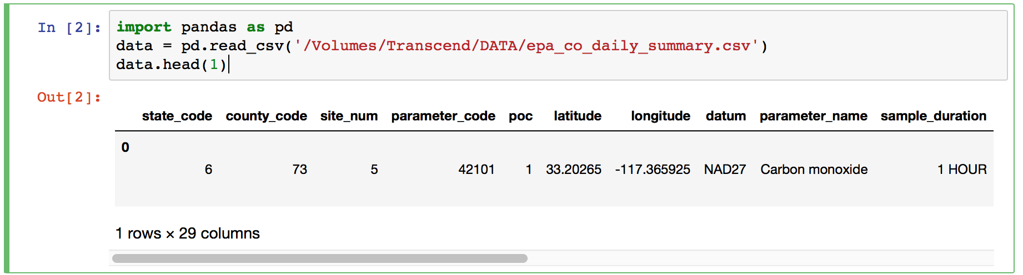
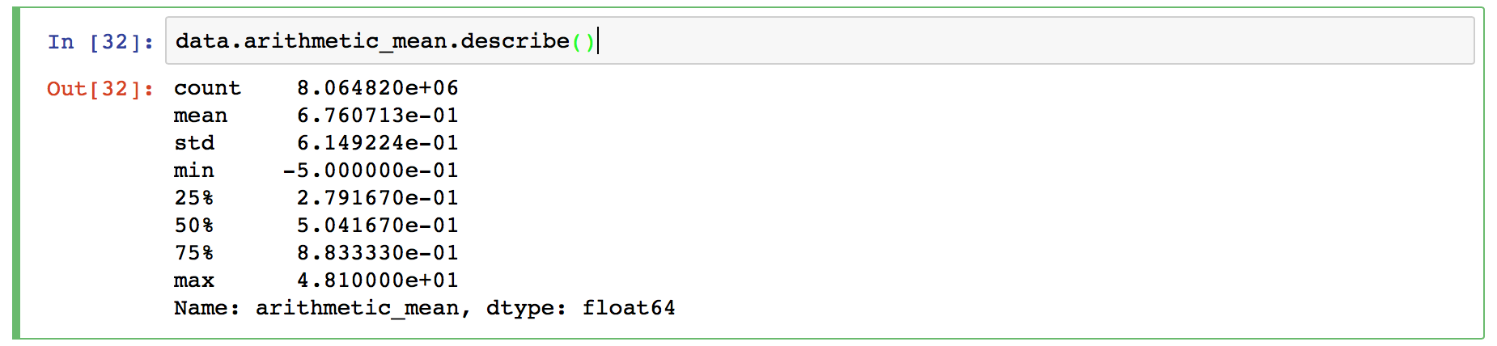
First look at the data with Pandas
Using downloaded and uncompressed local file
Checking data format, statistical distribution of main data item
Notes:
By now, students should be proficient in using Pandas.

Slide 15
What can we do with the data?
Find the range of CO pollution in different years
Pick up more polluted places, plot them
Index the data by date
Plot the polluted areas by years
(next step might be trying to predict next year)
Notes:
Discuss other choices for analysis.

Slide 16
Areas with pollution over 2 standard deviations
The yearly changes indicate some trend - what is that?
Notes:
This sample is just one possibility!

Slide 17
Self-study hints
Dig deeper! What is the micro-structure, in space and time? Is the change linear, log?
Try finding correlations! What changes together with what else? Why?
Try to find related information!
Traffic volumes (place, time)
Car emission standard changes Can we find good predictors for trends?
Notes:
Assignment: present a different exploration of the EPA CO dataset
Consider:
plotting the changes at different places
finding correlated temporal developments
finding clusters with fast and slow decrease

Slide 18
Useful references
A freely available book dealing with spatial analysis in the R language: http://spatial-analyst.net/book/system/files/Hengl_2009_GEOSTATe2c1w.pdf
A website for help in spatial analysis: https://www.spatialanalysisonline.com/HTML/index.html?spatial_sampling2.htm

Slide 19
Summary of the lecture
We have learned about using the Pandas library and other Python libraries for analyzing a large spatio-temporal sensory dataset.
In this specific case, dynamic visualization seems to let us develop a general understanding of the process behind the data. We have to be careful, however, not to imagine that this will always be the case.
This case study requires active experimenting.

